Slide 1

Group Project 1
Team Members
Abhidnya - PM
Talieh
Peter Tram
Yared Haile

Slide 2
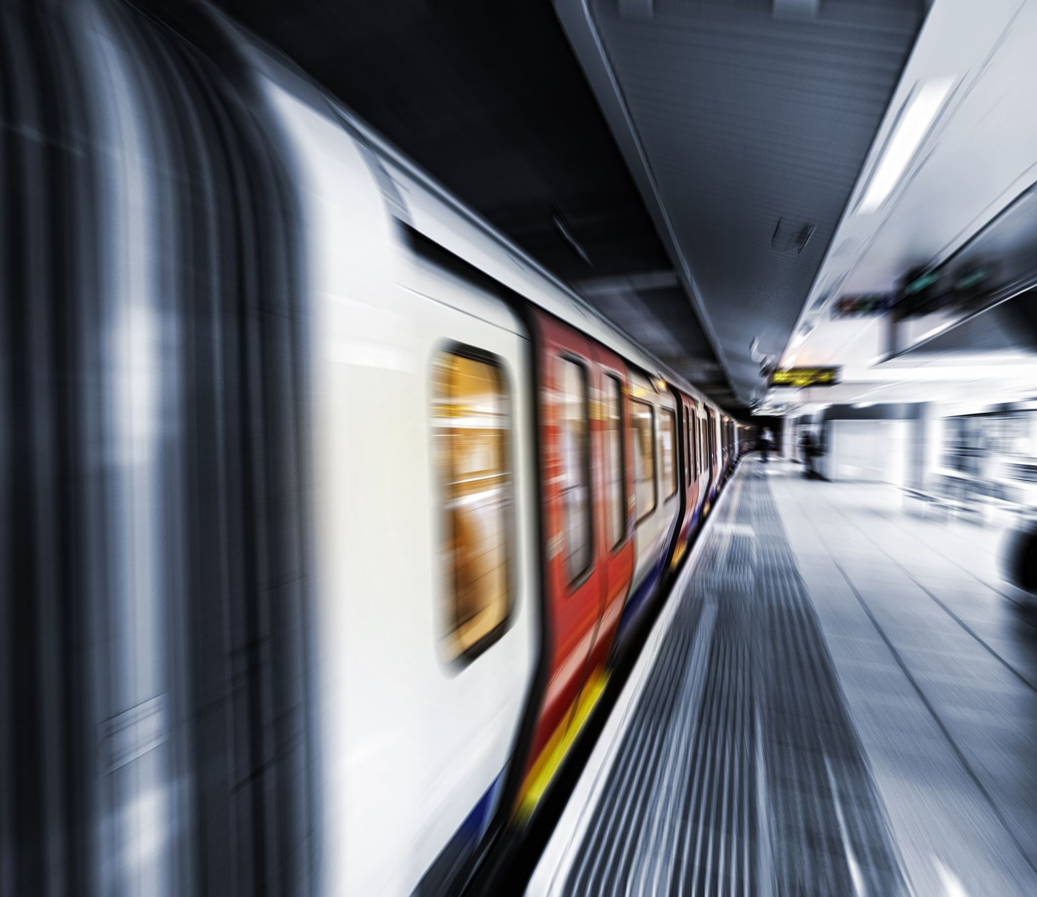
Project Title Melbourne Metro Transport Trends by passenger footfall
Proposal
The primary objective of this project is to conduct a comprehensive analysis of public transport trends in Melbourne over the period from 2018 to 2023. This analysis will place a specific emphasis on the performance and usage patterns of the metro train system. Additionally, the project seeks to explore potential correlations between public transport trends and real estate trends, particularly property sales.

Slide 3

Data Sources
The project will draw its main data from the Department of Transport and Planning under the Government of Victoria and Property sales statistics. The team will also utilize insights from the VISTA survey to enrich the analysis.

Slide 4
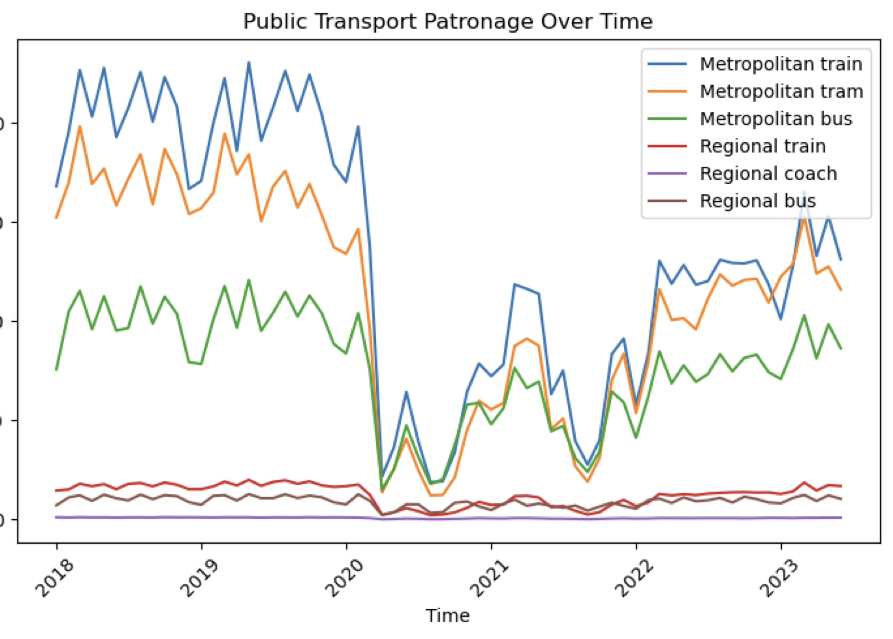
Public Transport Patronage

